Slide 1
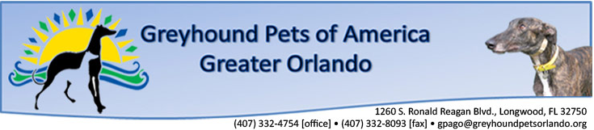
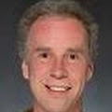
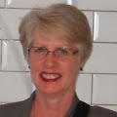
Mentor: Dr. A |  | Sponsor: Wendy Allison
Professor: Marwan Shaban
Phillip Bess | Manuel Gutierrez | Patrick McAleavey | Jamie Smith | Jeffrey Woodard

Slide 2
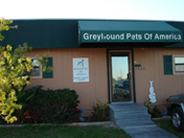

About Greyhound Pets of America/Greater Orlando Chapter
Greyhound Pets of America/Greater Orlando is a non-profit corporation founded in 1996, as a chapter of
the National Greyhound Pets of America organization. Our purpose is to find homes for ex-racing Greyhounds and to educate the public on the suitability and availability of Greyhounds as pets.

Slide 3

Need/Problem/Opportunity
Display available Greyhounds for adoption
manually enter every greyhound in html
table after table
user not a developer
time-consuming
4000+ lines html

Slide 4
Need/Problem/Opportunity (cont.)
Solution:
Web Application
Dynamically Generate html each time a Grey is entered
Technologies Used:
Linux Server
GitHub
JetBrains – YouTrack

Slide 5
Architecture Overview
Java based web application
Servlets and Java Server Pages to render HTML to the client
Tomcat is used as web server and servlet container
MySql database used for persistence
Java Persistence API used for object-relational mapping

Slide 6
Model-View-Controller (MVC) Pattern
Web Browser Client
HTML / Javascript
View
Internet
Java Server Pages
Controller
Java / Servlets
Model – JPA Entities
Model
MySql Database

Slide 7
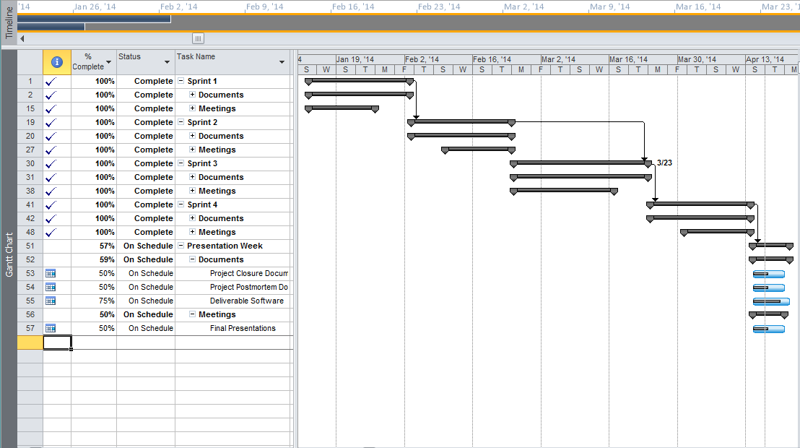
Schedule
Single group meeting each week
Members collaborated as needed
Used Scrum method
Tracked progress with MS Project
Some work done during the week but more activity on weekends

Slide 8
Progress/Status
Met with sponsors on a weekly basis to ensure customer satisfaction and get constant feedback.
We were able to meet all the requirements of the project.
Provided documentation to help deploy and maintain the application.

Slide 9
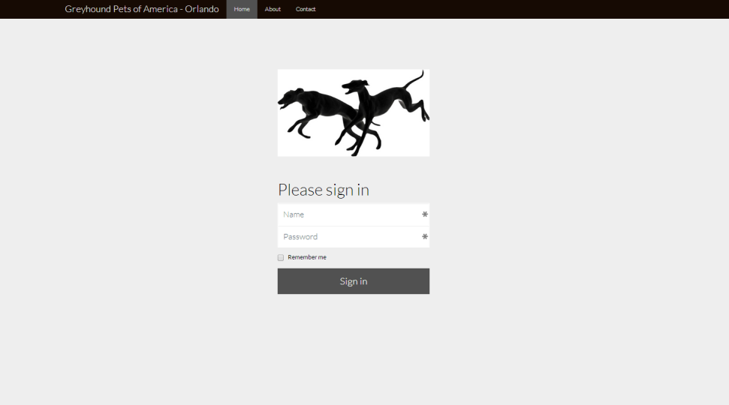
Login page

Slide 10
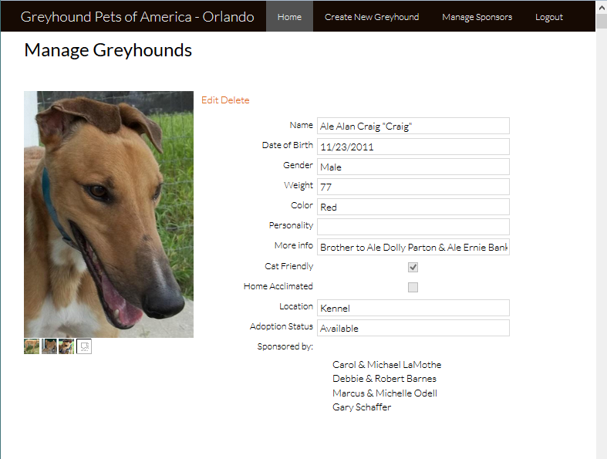
Manage Greyhounds page

Slide 11
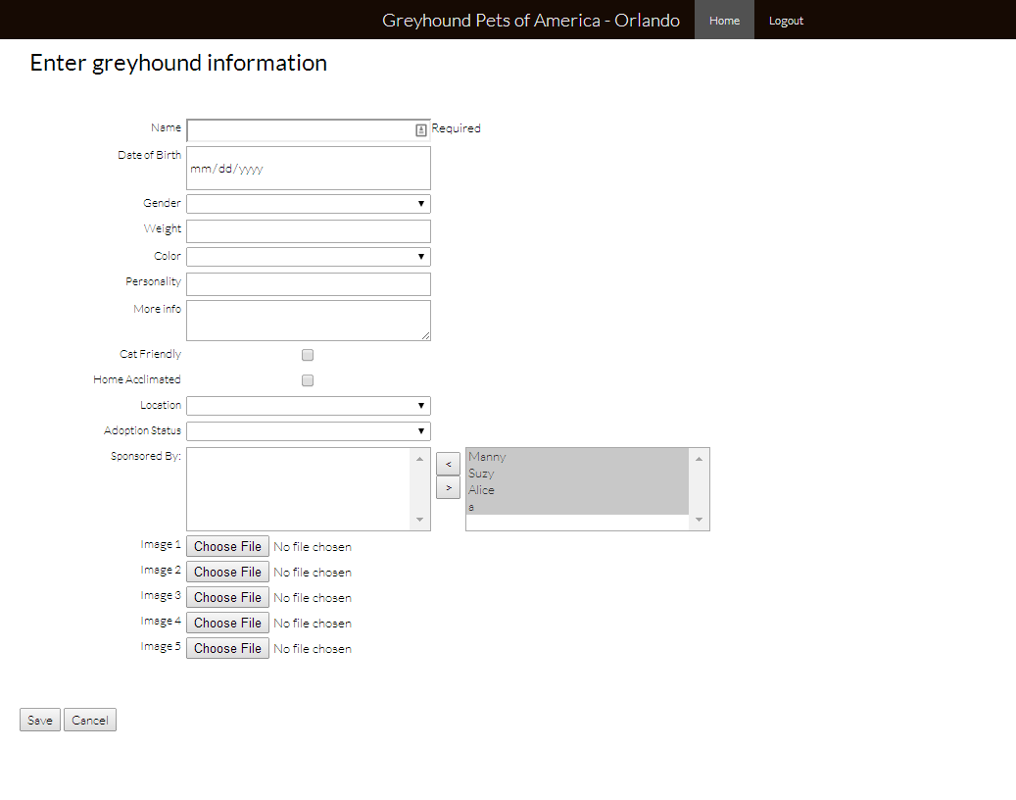
New/Edit greyhound form

Slide 12
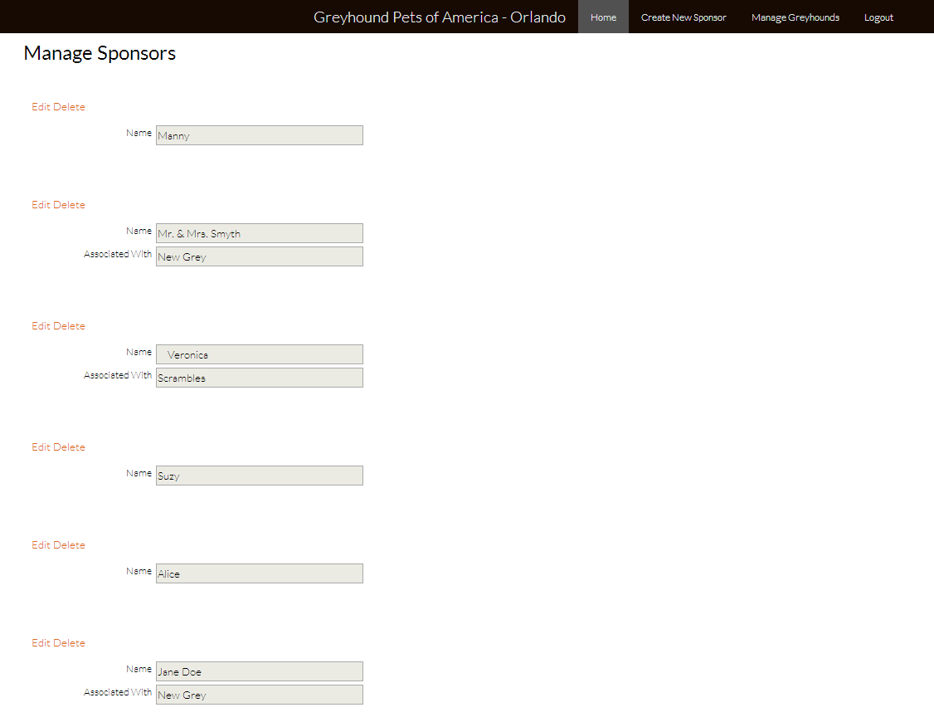
Manage Sponsors page

Slide 13
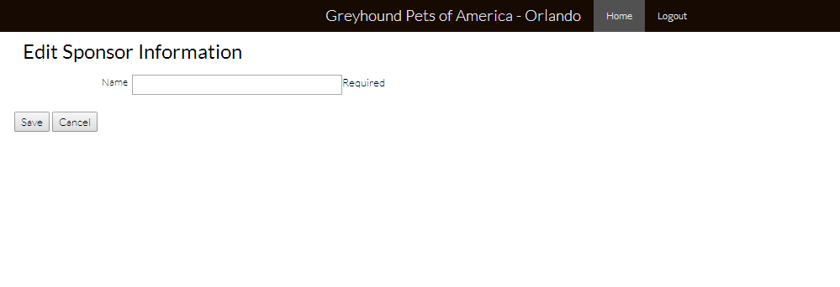
New/Edit sponsor form

Slide 14
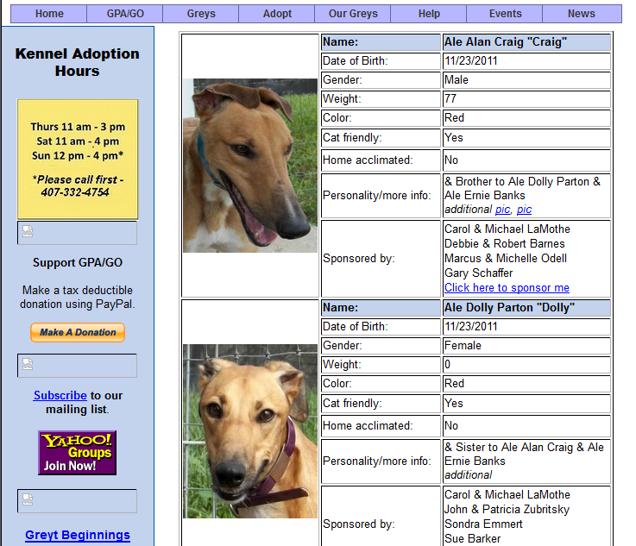
Available Greys page

Slide 15
DEMO

Slide 16
Issues/Risks
Time: There simply is not enough of it (:
More tools More problems(at least at first)
Becoming a cohesive team in such a short amount of Time…..
Overcoming the small obstacles/distractions that pile up

Slide 17

Postmortem Summary

Slide 18
Postmortem Summary
There is still so much to learn..
We have a great foundation to draw upon
We have a great team of young developers with various skills and talents
The project is never done.

Slide 19
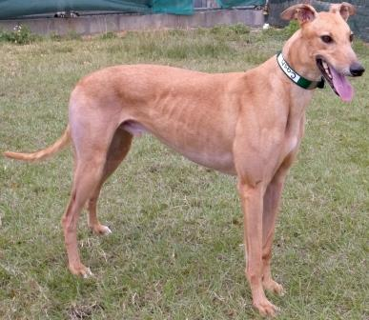
Greyhound Software Development Team
We code because we care

